Slide 1
SCIENCE AND RESEARCH FUNDING OPPORTUNITIES AT FHS UK
Basic information for Ph.D. students

Slide 2
Outline of presentation
Part I (17:35-17:55)
Basic types of support for science and research
Specific research and COOPERATIO Program
Part II (17:55-18:10)
COOPERATIO Sociology and Applied Social Sciences
Time for questions (18:10-18:25)
Part III (18:25-18:40)
COOPERATIO: How to apply
Time for questions (18:40-18:50)

Slide 3
Research funding available for Ph.D.´s –basic level
1) EXTERNAL (earmarked) FUNDING
implemented through specific grants and projects from external (outside the Faculty) providers
typically grant agencies (GAUK, GAČR, TAČR) and resort programmes of targeted support (AZV, NAKI, etc.)

Slide 4
Research funding available for Ph.D.´s –basic level
2) INTERNAL (institutional) FUNDING
Institutional (CH.U.) funding provided by the Czech Republic Government ("long-term conceptual development of the research organisation" -DKRV)
At the level of Charles University distributed through
the COOPERATIO research programmes
SPECIFIC UNIVERSITY RESEARCH (SVV) programme.

Slide 5
Specific University Research (SVV)
At FHS UK, this funding is distributed at the level of faculty´s departments
The lead researcher of a SVV project is an academic who prepares a project proposal and forms a team of academics, Ph.D. and MA students to work on the project together.
Could be research project or conference (one year only)
Research or conference activities are conducted primarily by students in the pursuit of accredited doctoral and master's degree programmes under the supervision of an academic staff member.
https://research.fhs.cuni.cz/FHSVEDAEN-26.html
For more info: get in touch with your Ph.D. supervisor or head of the department

Slide 6
COOPERATIO Programme
Functions as a discipline based; created across various parts of the University (Faculties)
Organisational instrument to effectively use CZstate funding for doing and sustaining research activities at Universities
involves all academic and scientific staff and Ph.D.students
NOT meant as a grant money (long term), meant as a „now and here“ support for concrete research activities related to Ph.D. research plan.
Functions in a one year´s schedule only

Slide 7
COOPERATIO Programmes at FHS UK
Arts and Culture Studies (ARTS)
Health Sciences (HEAS)
History (HIST)
Literature (LITE)
Media And Communication Studies (MCOM)
Philosophy (PHIL)
Psychological Sciences (PSYC)
Social and Cultural Anthropology (SCAN)
Sociology and Applied Social Sciences (SOAS)

Slide 8
COOPERATIO Programme – links to FHS departments
ARTS - Arts and Culture Studies | Dpt. of Theory of Art and Artworks
HIST - History | Dpt. of Historical Studies
LITE - Literature | Dpt. of Languaegs and Literature
MCOM - Media And Communication Studies
PSYC - Psychological Sciences | Dpt. of Psychology and Life Sciences
HEAS - Health Sciences
PHIL - Philosophy | Dpt. of Philosophy
SCAN - Social and Cultural Anthropology | Dpt. of Social and Cultural Anthropology
SOAS - Sociology and Applied Social Sciences | Dpt. of Sociology
 | Dpt. of Applied Social Sciences

Slide 9
How any Ph.D. student becomes a part of a COOPERATIO Programme
Assignment process of Ph.D. students to a concrete Cooperatio programme respects specificities of study programme Ph.D. student is accepted to study at FHS. There are two important sources for the process of a assignment:
research areas relevant to S.P. (expertise of the guarantee of a S.P.)
topic of a concrete Ph.D. project (expertise of their supervisor)
Each Ph.D. student is assigned to one scientific discipline; in case that the Ph.D. student's scientific activity is demonstrably split between two scientific disciplines, they may also be assigned for second discipline
What matters the most is your primary research identity (the first Cooperatio)

Slide 10
Cooperatio science areas links to FHS UK Ph.D. study programmes
STUDIJNÍ PROGRAM | VĚDNÍ OBORY | OBLASTI COOPERATIO
Aplikovaná etika | o Philosophy and Ethics o Social Work | PHIL + SOAS
Applied Ethics
Historická sociologie | o History o History and Philosophy of Science o Sociology | HIST + SOAS
Historical Sociology
Německá a francouzská filozofie | o Philosophy and Ethics | PHIL
Philosophies allemande et française
Deutsche und französische Philosophie
Obecná antropologie | o Social and Cultural Anthropology o Ethnology o History o History and Philosophy of Science o Philosophy and Ethics o General and Developmental Psychology o Health and Clinical Psychology | SCAN + HIST + PHIL + HEAS + PSYC
General Antropology
Sémiotika a filozofie komunikace | o Philosophy and Ethics o Media and Communication Studies | PHIL + MCOM
Semiotics and Philosophy of Communication
Sociální ekologie | o Public and Social Policy o Sociology | SOAS
Social Ecology
Soudobé evropské kulturní dějiny | o History o History and Philosophy of Science | HIST
Europäische Kulturzeitgeschichte
Contemporary European Cultural History
Studia dlouhověkosti | o Health and Clinical Psychology o Social Work o Sociology | HEAS
Longevity Studies
Studia občanského sektoru | o Sociology o Public and Social Policy | SOAS

Slide 11
Gremium of SOAS (Sociology and Applied Social Sciences)
Mgr. Ondřej Špaček, Ph.D. (Dpt. of Sociology – Head)
Mgr. Dana Hradcová, Ph.D. (Dpt. of Applied Social Sciences – Head)
Doc. Věra Sokolová, Ph.D.
Doc. Monika Bosá, Ph.D.
Doc. Ing. Marie Dohnalová, CSc.
Doc. Tereza Pospíšilová, Ph.D. – Coordinator of SOAS at FHS UK
Scientific Council of COOPERATIO SOAS at Charles University

Slide 12
Examples of doctoral students' projects supported last year:
Data processing for publication in a foreign peer-reviewed journal: contribution in the form of a scholarship for data transcription (15 in-depth interviews), data analysis and writing a scientific article in the period October-December 2022 in the amount of 3 x 9,000 CZK; output: submission of the manuscript for peer-review in the Journal of Illiberalism Studies in autumn 2022 (total: 27,000 CZK).
The role of population data in ecosystem services assessment: the project deals with the use of demographic and socio-economic population data in the assessment of urban ecosystem services. Conference paper „The role of population data in urban ecosystem service assessments: A case study of microclimate cooling in Prague, Czechia“ has been accepted for thge international konference Ecosystem Service Partnership 2022, 10.-14.10. 2022, Heraklion, Greece (total: 32 000 Kč).

Slide 13
Examples of doctoral students' projects supported last year (continued):
Understading and Perception of Reflection in Higher Nursing and Social Work programs: The intended output will be a publication offered to an international journal (e.g. European Journal of Social Work) in the early spring 2023. The article will describe the Q methodology as a research instrument (…). The interest in this methodology was noted after my presentation of the methodology and its application to a pilot study at the international social work conference in Ghent this Summer (total: 10 000Kč).

Slide 14
Administration of COOPERATIO SOAS
The main contact point: Department of Science and Research FHS (see further): Ing. Jan Bělonožník, Mgr. Renata Wilflingová
Department of Sociology (also on behalf of Dpt. of Applied Social Sciences): assisstant Barbora Benešovská, barbora.benesovska@fhs.cuni.cz
New section on the www page of the department (by end of March)
https://fhs.cuni.cz/FHS-2497.html

Slide 15
How to apply for funding from Cooperatio?
Applications can be submitted within the framework of the CALLS, which are announced during the year on the website of the Department of Science and Research FHS https://veda.fhs.cuni.cz/FHSVEDA-196.html.
The calls are designed either as faculty-wide calls (so-called „Strategic Priorities“), which are open to everyone across all the research and science fields, or „Branch Calls", which are open only to those assigned in the relevant Cooperatio discipline.
Applications shall be submitted on the prescribed form, within the required deadlines and in accordance with other proposals of the specific Call.
In the case of Ph.D. students, the WRITTEN SUPPORT OF THEIR SUPERVISORIS A REQUIRED PART OF THE APPLICATION!
The submitted applications are reviewed by a Board consisting of representatives of FHS UK in the relevant Cooperatio Council and the head of the relevant department. The Board has the right to request any further relevant information. The Board decides on the approval/disapproval of applications for funding and on any adjustments to the proposed budgets.

Slide 16
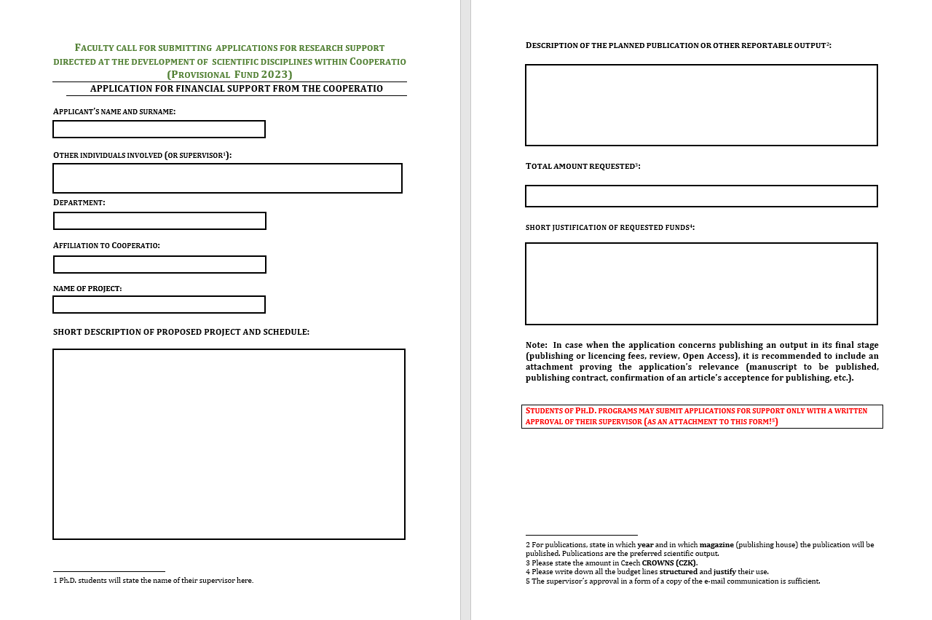
Application Form:

Slide 17
Eligible costs within Cooperatio?
costs or expenditures as defined in Section 2(2)(m) of Act No. 130/2002 Coll., on support for research and development from public funds.
Examples of eligible expenses:
Publication costs (incl. Open Acces costs)
Translations, proofreading services
Conference fees
Travel insurance
Acommodation (travel expenses)
Travel expenses (travel, accommodation) associated with research stays, research trips, active participation at conferences
Purchase of materials and other services (e.g. literature, copying fees, posters, etc.)

Slide 18
Current open Call – Provisional 2023
During January – March 2023
Priority will be given to funding those scientific and research projects, that are expected to be implemented in the first third of 2023.
After this period, Cooperatio open calls for 2023 will be announced
within scientific areas of FHS and
possibly also at the level of the whole Faculty (so called „strategic priorities“ funds)
https://veda.fhs.cuni.cz/FHSVEDA-218.html

Slide 19
Thank you :-)
Science and Research Department FHS UK
veda@fhs.cuni.cz
https://fhs.cuni.cz/FHS-11.html

